Slide 1
Defensive Security Project
by: [Jase, Oscar, Jason, Jake]

Slide 2

Monitoring Environment
‹#›

Slide 3
Scenario
We will be playing the role of an SOC analyst at a company called Virtual Space Industries (VSI), which designs VR programs for other businesses.
JobeCorp is a competitor that is rumored to disrupt VSI by launching cyberattacks to slow down business .
While working as an SOC analyst, we were tasked with using Splunk to monitor and gauge potential attacks on our system and applications.

Slide 4
Table of Contents
This document contains the following resources:
Monitoring Environment
Attack Analysis
Project Summary & Future Mitigations

Slide 5
[“Add-On” App]
‹#›

Slide 6
Website Monitoring
[Summary of add-on app chosen.]
This add-on app detects performance issues and downtimes.
Features of this app include:
Status Monitoring Dashboard that shows response time of the monitored website and can show a history of data collected.
Change History Dashboard that shows changes in monitored website
Health menu that can help analyze both logs and status
Can be configured to have further visualizations and send an email alert if the website goes down

Slide 7
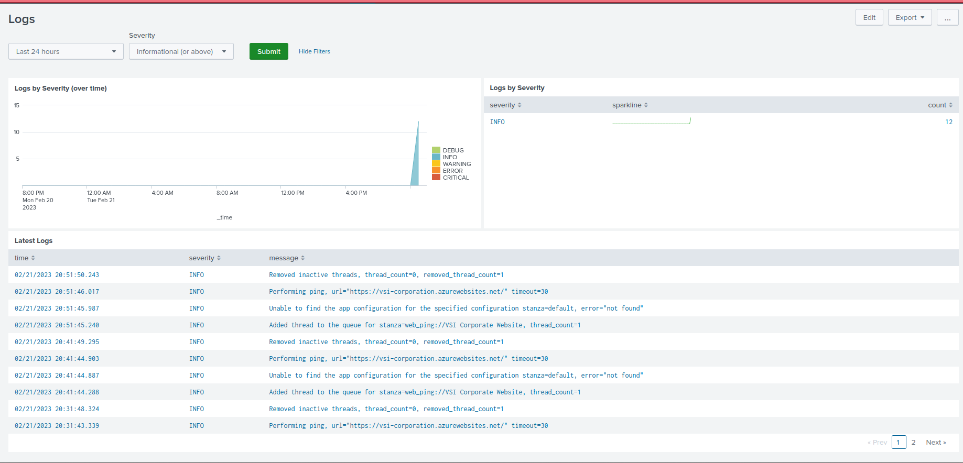
Website Monitoring
[Scenario that illustrates benefit of add-on app.]

Slide 8
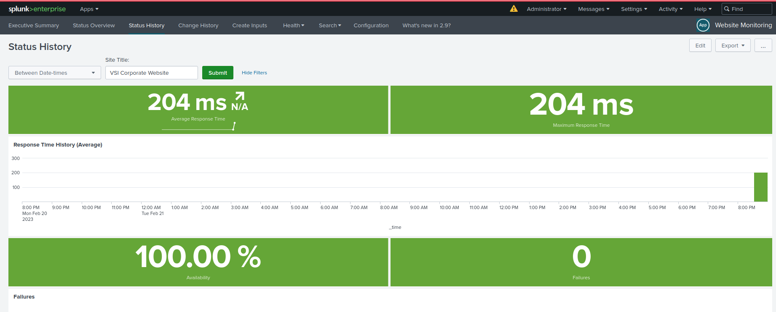
Website Monitoring

Slide 9
Logs Analyzed
Windows Logs
Apache Logs
1
2
These logs contain a lot of user login data and actions performed by users.
Logs for VSI’s main website vsi-company.com

Slide 10
Windows Logs
‹#›

Slide 11
Reports—Windows
Designed the following Reports:
Report Name | Report Description
Success and Failure | A report showing whether or not there is a suspicious level of failed activities
ID Number | Report showing the ID number associated with specific signatures
Severity Report | A report showing the severity levels of logs being analyzed.

Slide 12
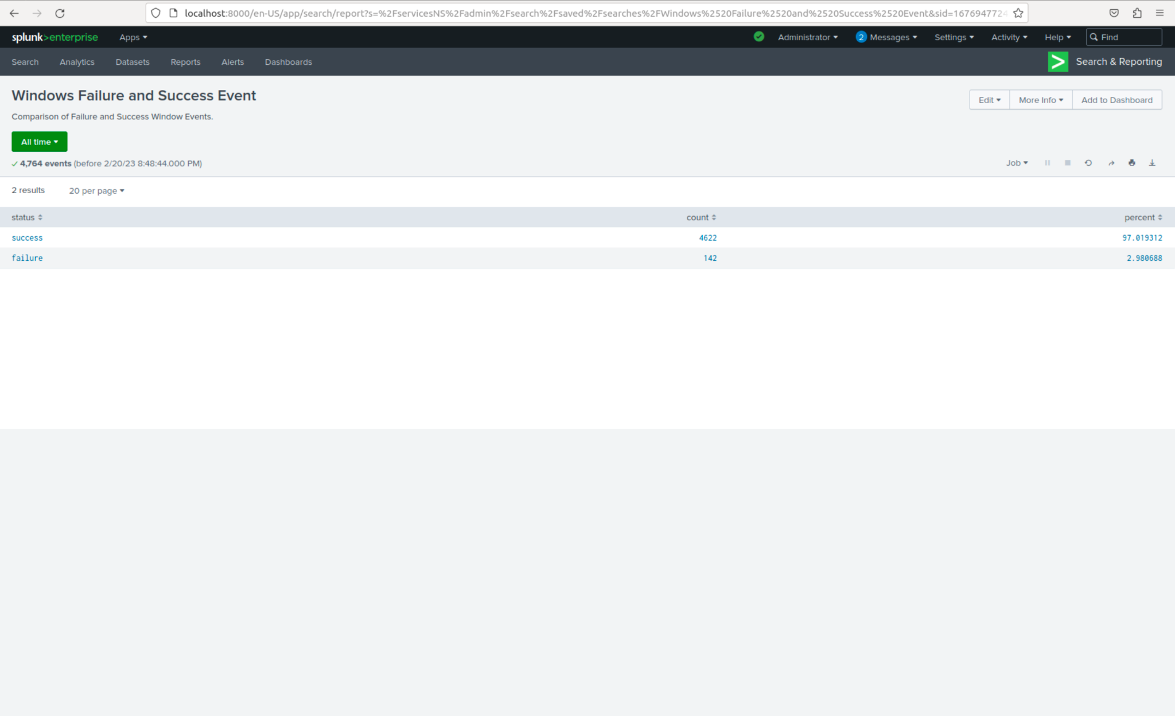
Image of Reports-Windows
Windows Failure and Success Events

Slide 13
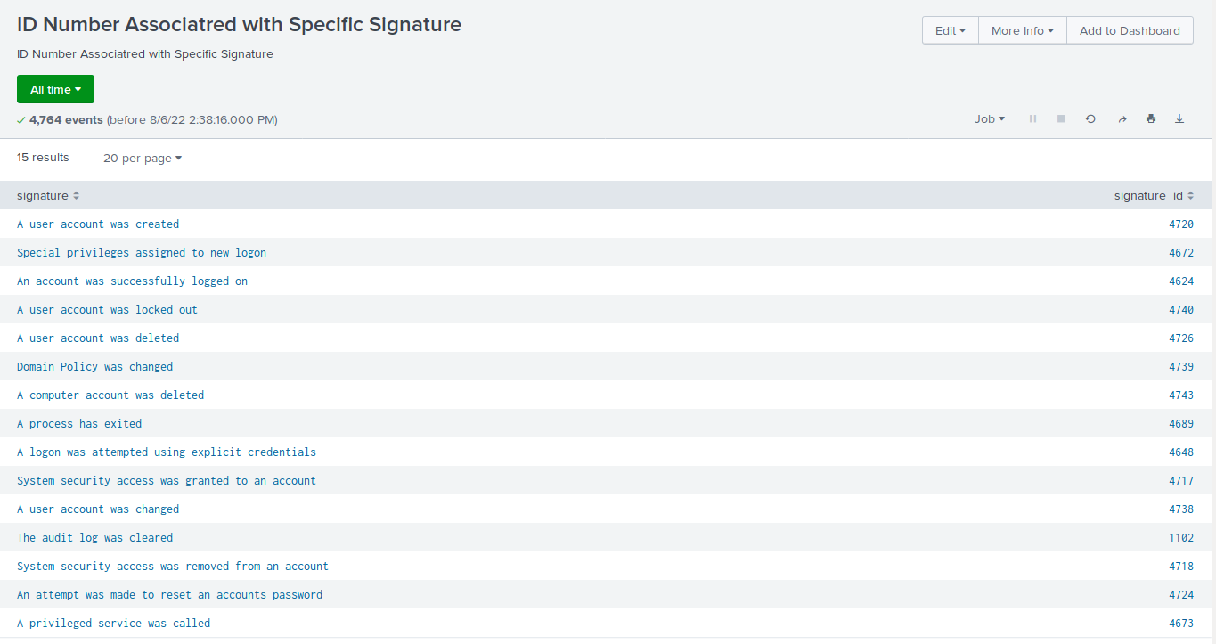
Images of Reports—Windows

Slide 14
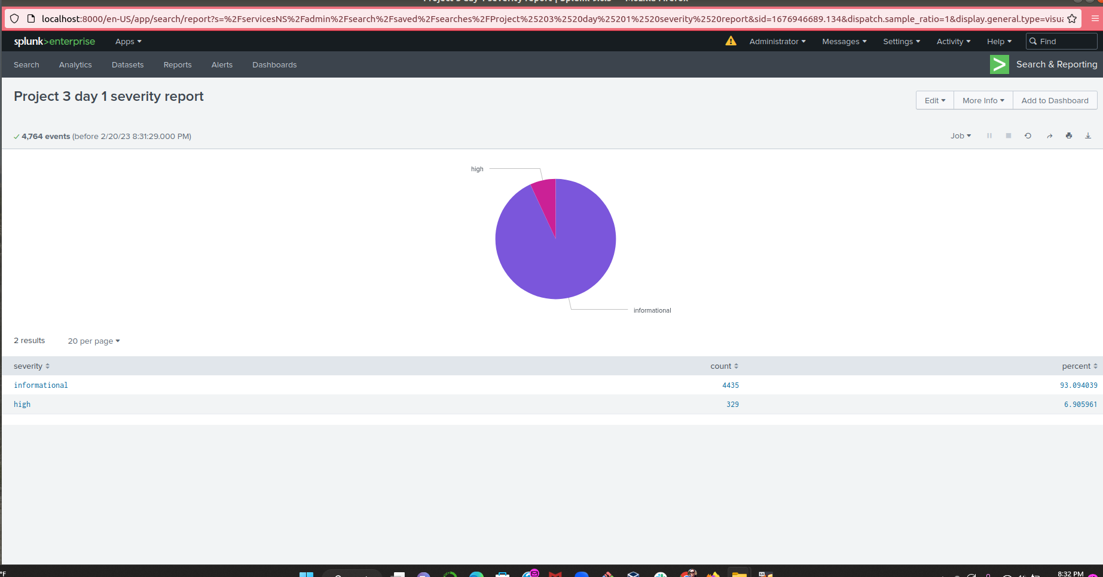
Image of Reports - Windows

Slide 15
Alerts—Windows
Designed the following alerts:
Alert Name | Alert Description | Alert Baseline | Alert Threshold
Windows Failed Activity | Threshold for Windows Failed activity was reached. | 6 | 12
JUSTIFICATION: The baseline is the average for failed windows activities. The threshold is well above the baseline limiting false alerts. If the threshold is surpassed it will be an indicator of possible malicious activity.

Slide 16
Alerts—Windows
Designed the following alerts:
Alert Name | Alert Description | Alert Baseline | Alert Threshold
VSI Account Successfully Logged on | Threshold of Successful Logged on by Account | 14 | 28
JUSTIFICATION: The average amount of successful logins rounded a little high, was 14. Our threshold was set higher after noting that we never saw activity that high. More activity than 28 would indicate malicious activity.

Slide 17
Alerts—Windows
Designed the following alerts:
Alert Name | Alert Description | Alert Baseline | Alert Threshold
Deleted User Accounts | Threshold for Deleted User Accounts | 14 | 28
JUSTIFICATION: We saw an average of 14 as our baseline per hour. Doubling that number would indicate malicious activity and indicate a problem.

Slide 18
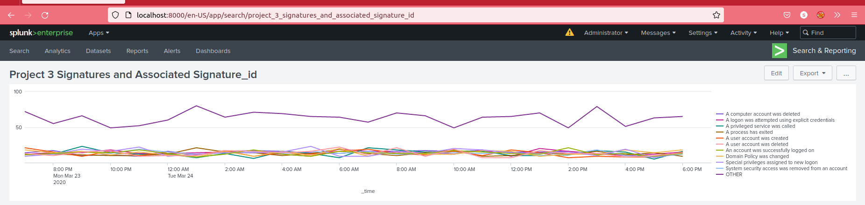
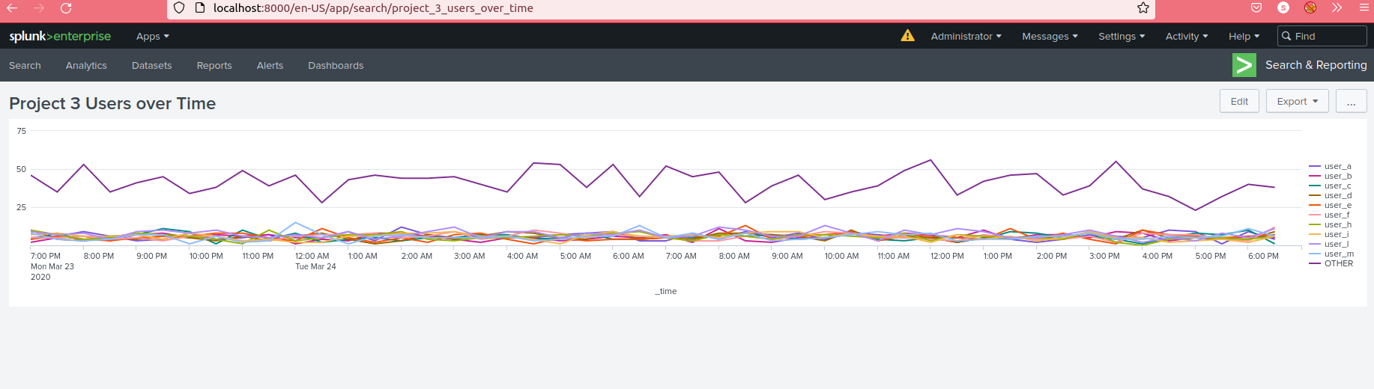
Dashboards—Windows
Place image here
Place image here
Place image here
Place image here

Slide 19
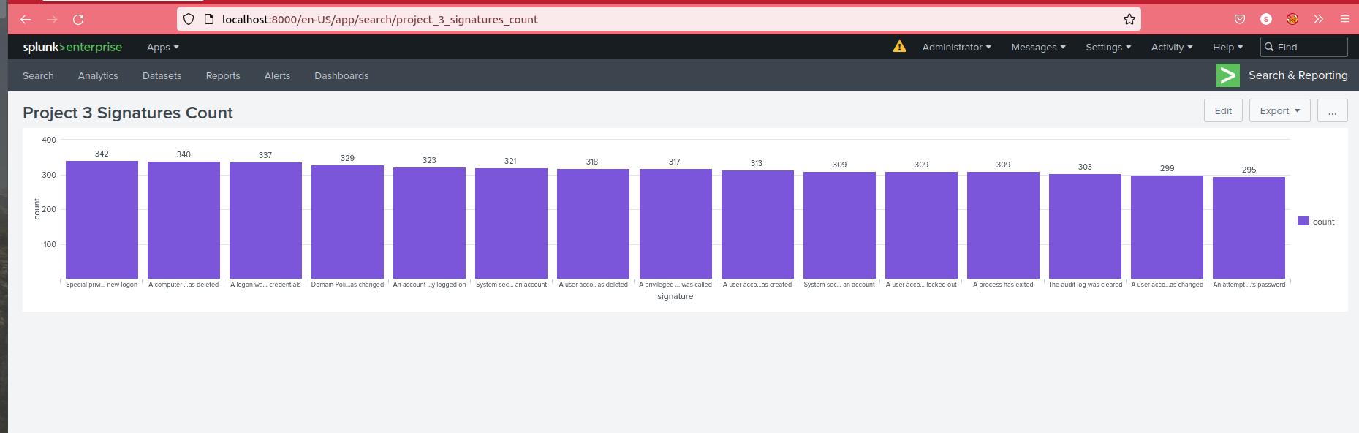
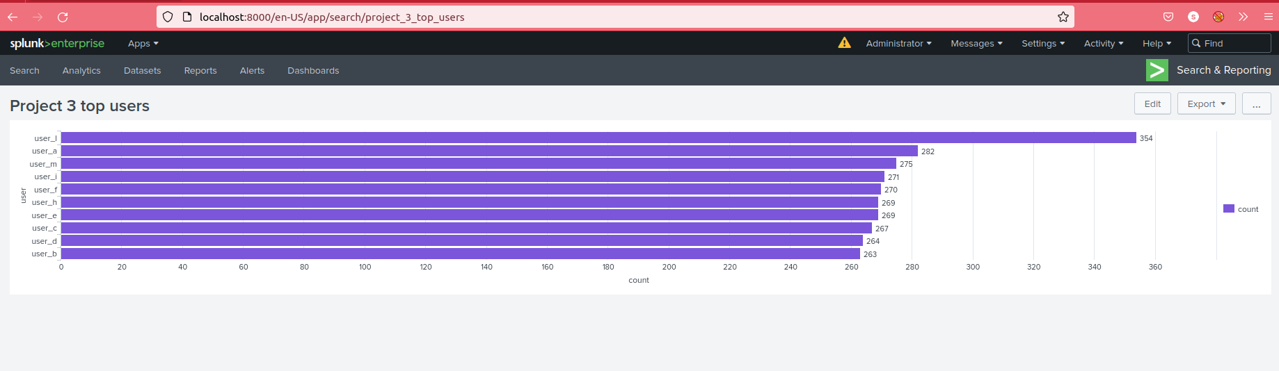
Dashboards—Windows
Place image here
Place image here
Place image here
Place image here

Slide 20
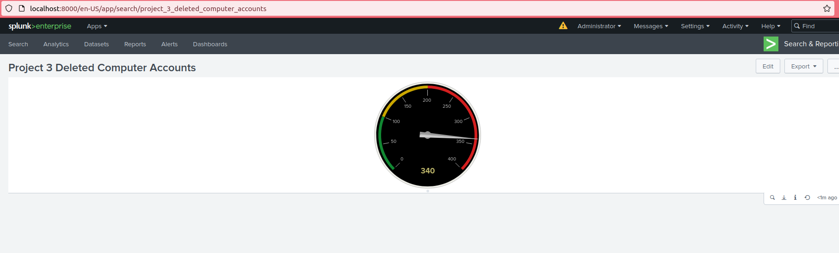
Dashboards-Windows

Slide 21
Apache Logs
‹#›

Slide 22
Reports—Apache
Designed the following reports:
Report Name | Report Description
HTTP Methods | Shows the count of HTTP methods.
Count of HTTP Response Codes | Shows the count of HTTP response codes.
Referrer Domain | Top 10 domains referring to VSI website.

Slide 23
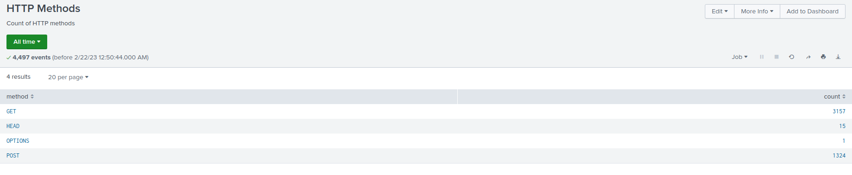
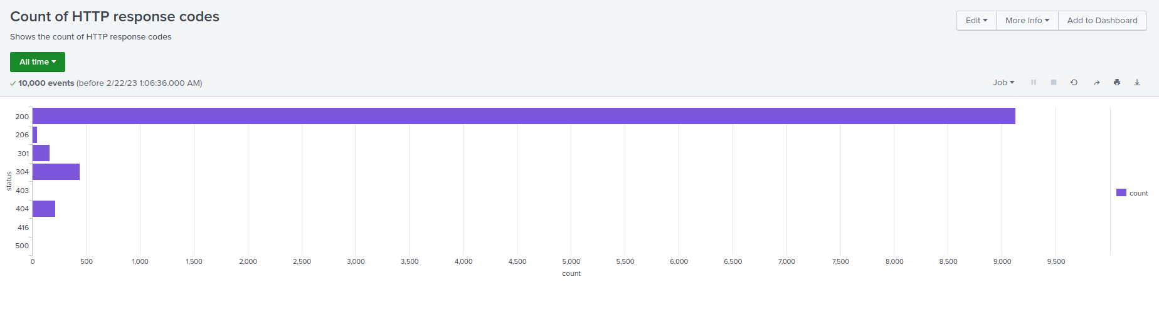
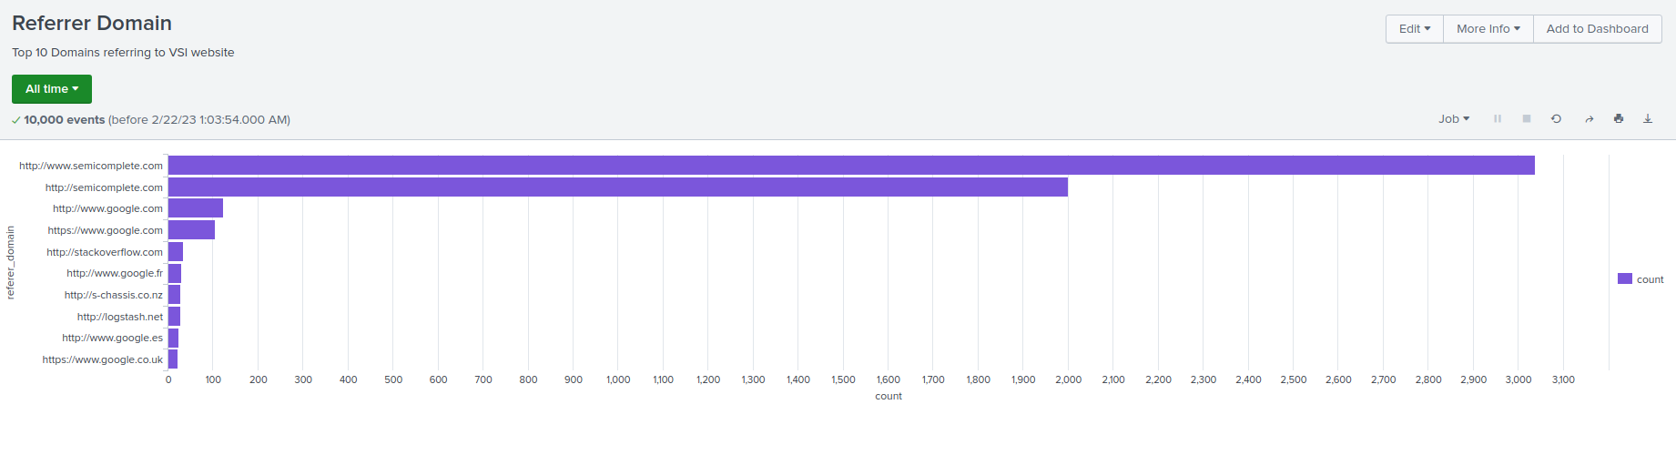
Images of Reports—Apache

Slide 24
Alerts—Apache
Designed the following alerts:
Alert Name | Alert Description | Alert Baseline | Alert Threshold
HTTP Post Count | Alerts if hourly HTTP POST method count passes the threshold. | 3 | 10
JUSTIFICATION: On average, there were between 1 and 4 events per hour, and the highest recorded was 7. Setting the threshold to 10 should ensure that there are no false alerts while still being able to detect malicious activity.

Slide 25
Alerts—Apache
Designed the following alerts:
Alert Name | Alert Description | Alert Baseline | Alert Threshold
International VSI Activity | Will alert if international activity exceeds the threshold. | 120 | 175
JUSTIFICATION: The average count of events in one hour was around 120, but never exceeded 175.

Slide 26
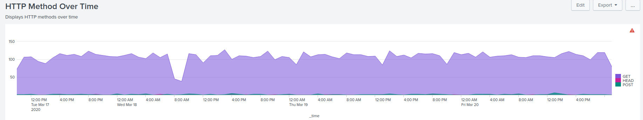
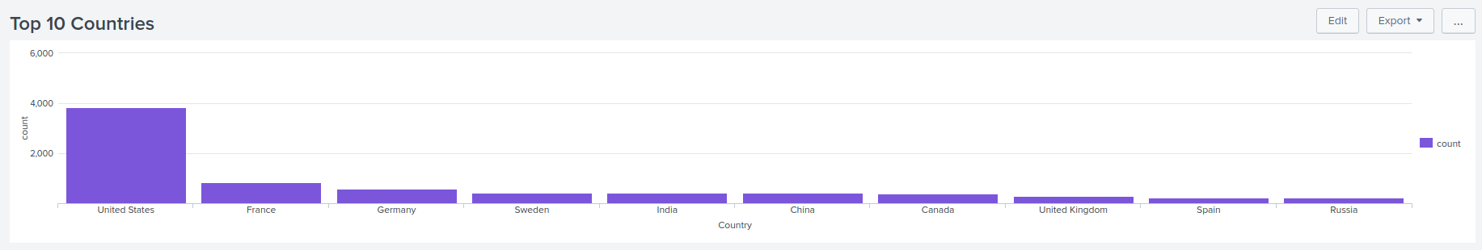
Dashboards—Apache

Slide 27
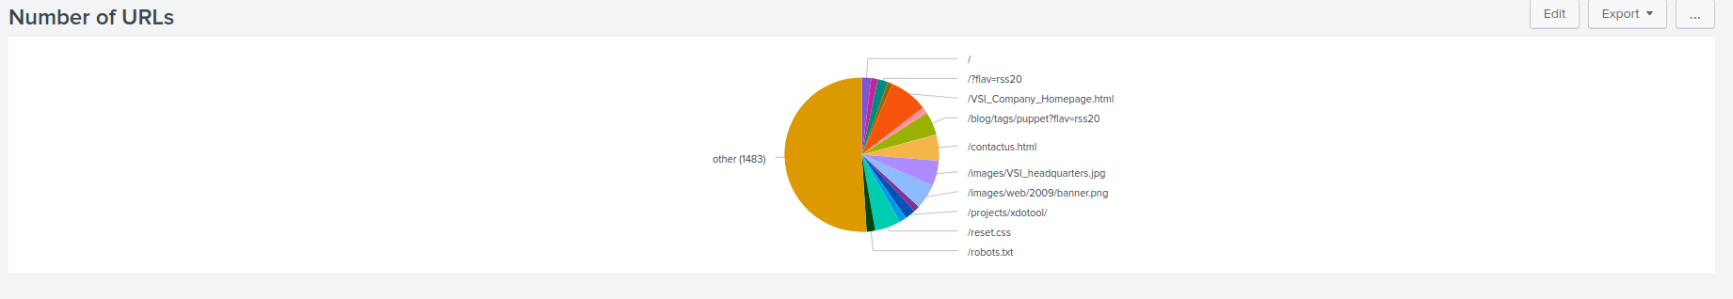
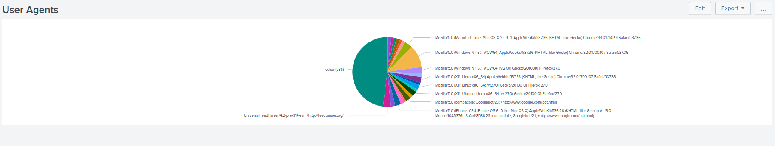
Dashboards—Apache

Slide 28
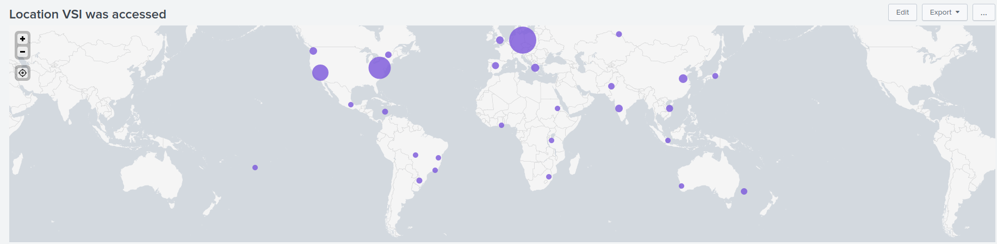
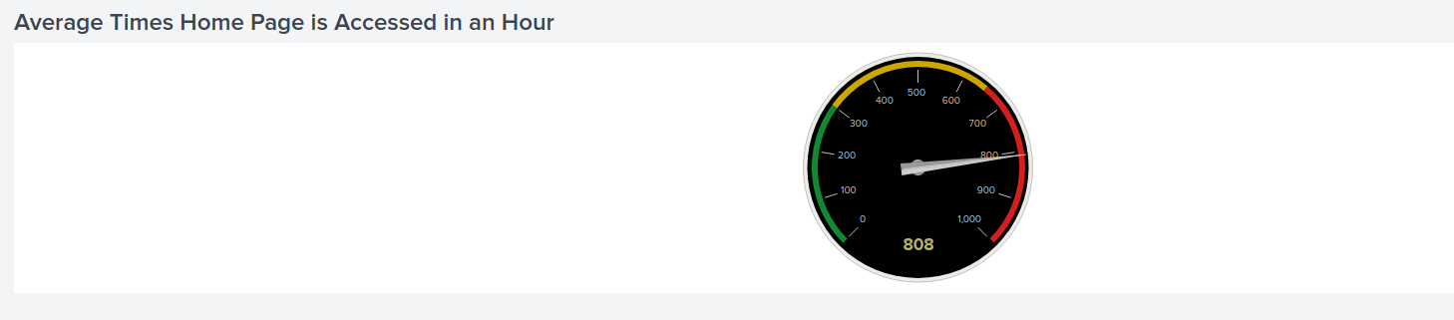
Dashboards—Apache

Slide 29
Attack Analysis
‹#›

Slide 30
Attack Summary—Windows
Summarize your findings from your reports when analyzing the attack logs.
The Windows attack system contained a multitude of levels in the “high” category compared to the “informational” which had only had around 5% seen before the attack. We had more success than we had failure after the attack was concluded. Alert analysis designated a lot of suspicious volume that had failed.
We detected 35 failed logins in that one hour that occurred on March 25, 2020 at 3:00am. Do not change the threshold. However, might consider having less alerts.
We detected 196 successful logins in that one hour that occurred March 25, 2020 at 6:00am. Do not change threshold because it would cause too many alerts.

Slide 31
Attack Summary—Windows
Summarize your findings from your alerts when analyzing the attack logs. Were the thresholds correct?
Alert analysis allotted to a high volume of failed activity.
Deleted Accounts
-Threshold was set to >10
-No suspicious volumes of deleted accounts
-Somethings suspicious that stood out was “A user account was locked out” and “An attempt was made to reset accounts password”
Counts for different signatures
-A user account -785
-An attempt -397

Slide 32
Attack Summary—Windows
Summarize your findings from your dashboards when analyzing the attack logs.
Had encountered a lot of suspicious activity by two users. User_A and User_K
-User_A started at 1:40 am and stopped at 2:40 am | Peak users: 785
-User_K started at 9:10 am and stopped at 11:00 am | Peak users: 397
Some suspicious activity that we had taken interest into was “An attempt was made to reset an accounts password” and “A user account was locked out.” High volumes of both activities were quickly noted.

Slide 33
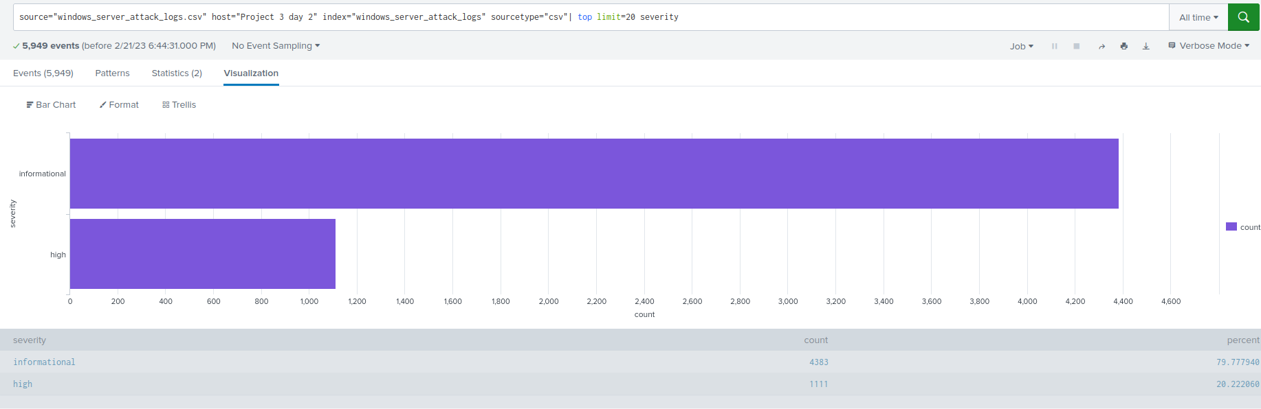
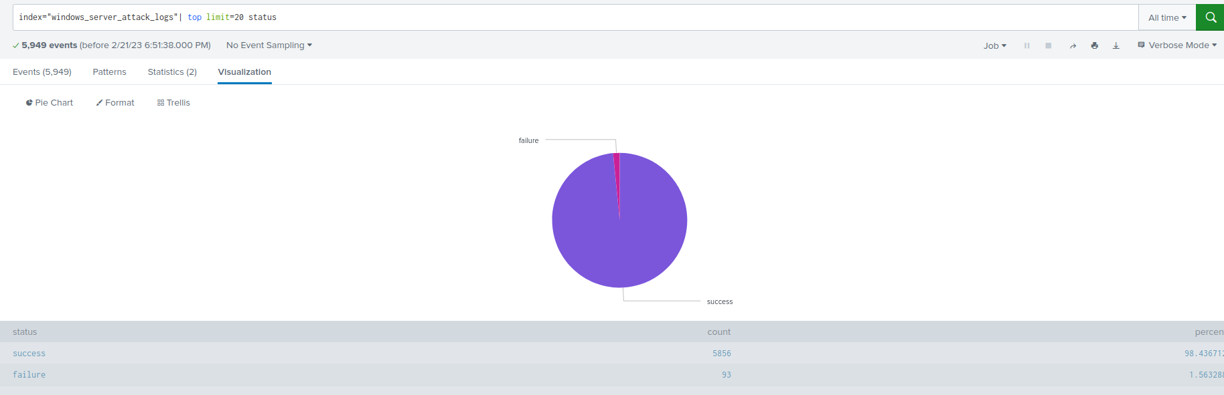
Screenshots of Attack Logs

Slide 34
Attack Summary—Apache
Summarize your findings from your reports when analyzing the attack logs.
We did not detect any unknown activity in referrer domains.
-it’s possible that the report didn’t catch it
Had a severe increase in HTTP, POST methods
The HTTP response codes report had signified that code 404 jumped from 3% to 15%

Slide 35
Attack Summary—Apache
Summarize your findings from your alerts when analyzing the attack logs. Were the thresholds correct?
We had detected a suspicious volume of international activity on March 25th at 8:00pm the count was 939.
-We wouldn’t want to change threshold, and the alert would have been triggered.
We detected more suspicious volume of international activity on March 25th at 9:00pm which hit our peak count which was 1296
-We had set the threshold to 15 which should be perfect.

Slide 36
Attack Summary—Apache
Summarize your findings from your dashboards when analyzing the attack logs.
The time chart of HTTP methods signified a large amount of suspicious behavior of GET and POST methods
-GET attack peaked with a count of 729 from the hours of 5:00pm-7:00pm
-POST attack peaked with a count of 1,296 from the hours of 7:00pm-9:00pm
The cluster map proclaimed suspicious activity in cities around the world.
-Some cities included D.C.-714, NYC-549, Kharkiv-433, Kiev-439

Slide 37
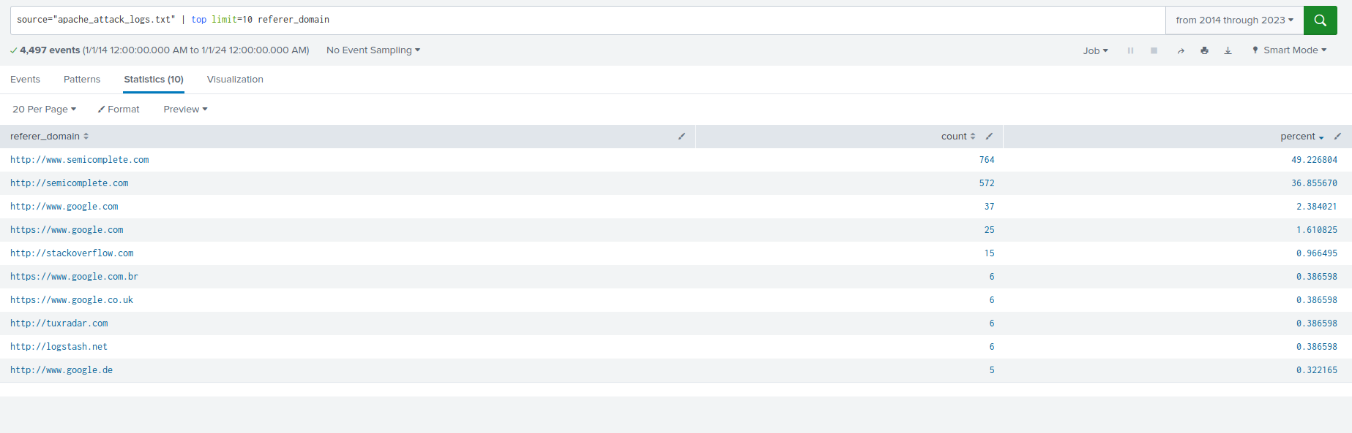
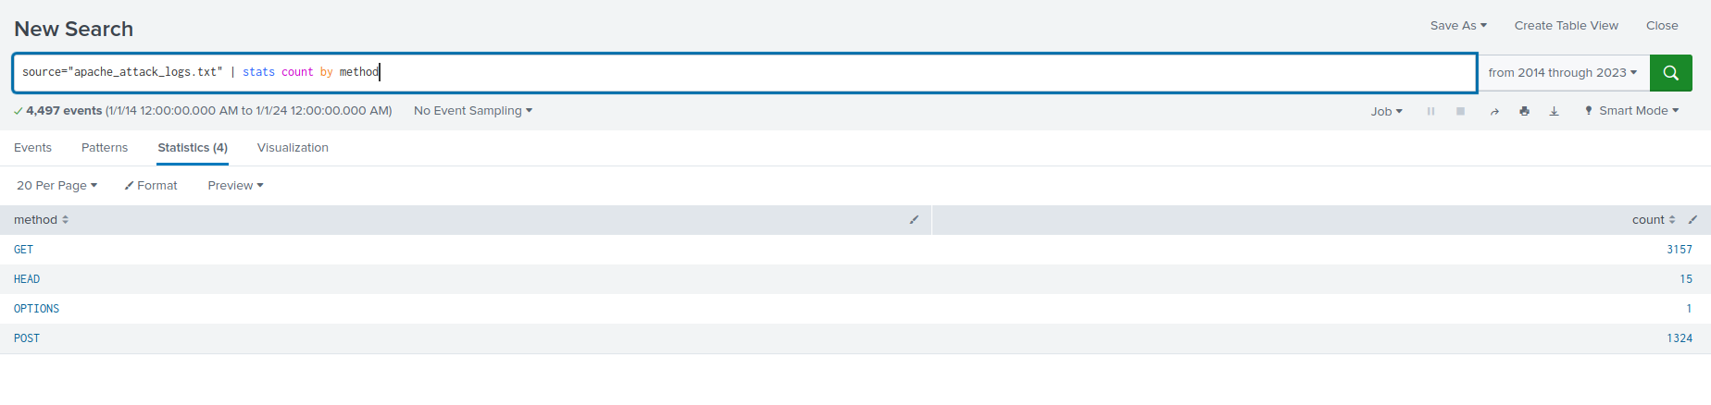
Screenshots of Attack Logs

Slide 38
Summary and Future Mitigations
‹#›

Slide 39
Project 3 Summary
What were your overall findings from the attack that took place?
Our group found that VSI had been the target of multiple attacks on their windows and apache servers. A majority of the attacks were found to be brute force attacks coming from many different places across the world.
To protect VSI from future attacks, what future mitigations would you recommend?
In order to protect VSI from future attacks, there are a couple changes that need to be implemented immediately. First, users should be locked out of their accounts after 3 failed login attempts, and second, two-factor authentication should be added to prove that the user is the owner of the account.

